Slide 1
Unit 1 chapter 3
Problem‐solving: Problem‐solving agents, Example problems, Searching for Solutions, Uninformed Search Strategies: Breadth First search, Depth First Search

Slide 2
Problem‐solving agents
A type of intelligent agent designed to address and solve complex problems or tasks in its environment

Slide 3
Problem Statement
Imagine an agent in the city of Arad, Romania, enjoying a touring holiday.
The agent’s performance : it wants to improve its suntan, improve its omanian, take in the sights, enjoy the nightlife, avoid hangovers, and so on.
agent has a nonrefundable ticket to fly out of Bucharest the following day.
Courses of action that don’t reach Bucharest on time can be rejected without further consideration and the agent’s decision problem is greatly simplified.
The agent’s task is to find out how to act, now and in the future, so that it reaches a goal state.

Slide 4
Three roads lead out of Arad, one toward Sibiu, one to Timisoara, and one to Zerind.
Agent should be familiar with the geography of Romania.

Slide 5
Consider the agent has a map of Romania.
map - provide the agent with information about the states it might get itself into and the actions it can take.
environment is observable(agent always knows the current state), environment is discrete(sign indicating its presence to arriving drivers)

Slide 6
Problem solving agents
Goal formulation: Based on current situation and the performance measure.
Problem formulation is the process of deciding what actions and states to consider ,given a goal.

Slide 7
Problem solving agents
A search algorithm - problem as input , solution in the form of action sequence.
Once a solution is found, the actions it recommends can be carried out➔ Execution phase.

Slide 8
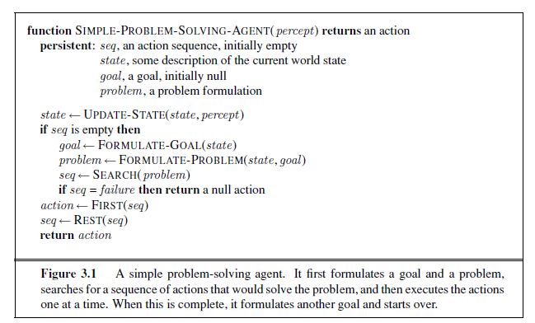

Slide 9
Well-defined problems and solutions
problem can be defined formally by five components
Initial state ,actions, transaction model, goal test, path cost
initial state :agent starts in. initial state :Romania as In(Arad).

Slide 10
actions :
A description of the possible actions available to the agent.
Given a particular state s, ACTIONS(s) returns the set of actions that can be executed in s.
Each of these actions is applicable in s.
For example, from the state In(Arad), the applicable actions are {Go(Sibiu), Go(Timisoara), Go(Zerind)}.

Slide 11
transition model
A description of what each action does;
function RESULT(s, a) that returns the state that results from doing action a in state s.
successor refer to any state reachable from a given state by a single action.
Example, RESULT(In(Arad),Go(Zerind)) = In(Zerind) .

Slide 12
initial state, actions, and transition model implicitly define the state space of the problem
State Space: the set of all states reachable from the initial state by any sequence of actions.
The state space forms a directed network or graph in which the nodes are states and the links between nodes are actions.
A path in the state space is a sequence of states connected by a sequence of actions.

Slide 13
goal test,
determines whether a given state is a goal state.
Sometimes there is an explicit set of possible goal states, and the test simply checks whether the given state is one of them. {In(Bucharest )}.
path cost
Numeric cost to each path.
sum of the costs of the individual actions along the path.
The step cost c(s, a, s ). assume that step costs are nonnegative

Slide 14
Example problem :Romania tour
On holiday in Romania .Currently in Arad
Flight leaves tomorrow at Bucharest
Formulate the goal
Be in Bucharest
Formulate the problem
State: various cities
Actions: Drive between cities
Find Solution
Sequence of cities eg. Arad, Sibiu, Fagaras, Bucharest

Slide 15
solution to a problem is an action sequence that leads from the initial state to a goal state.
Solution quality is measured by the path cost function
optimal solution has the lowest path cost among all solutions

Slide 16
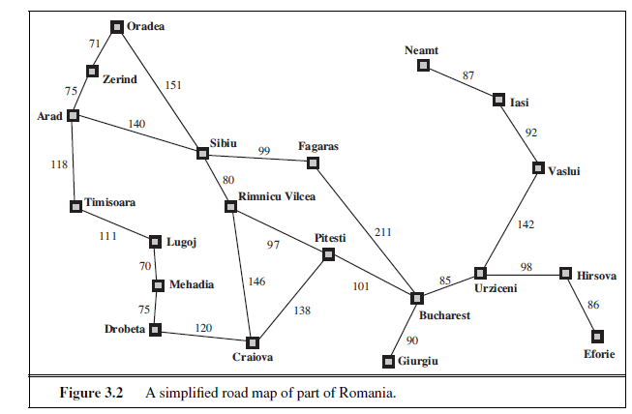

Slide 17
Single state problem formulation
A problem is defined by 4 items
1.Intitial state: Eg” at Arad”
2.Actions or Sucessor function
s(x)=set of action state pairs
Eg: S(Arad)={<Arad->Zerind,Zerind>,….}
3.Goal test
Explicit eg x=at Burcharest”
Implicit eg:Chekmate(x)
4.Path cost function(additive)
Eg.Sum of distances,#actions executes,etc
C(x,a,y) is the step cost ,assumed to be >or equal to 0
5.A solution is a sequence of actions leading from the initial state to a goal state

Slide 18
Selecting a State Space
Real world is absurdly complex, therefore state space must be abstracted for problem solving
(Abstract) state=set of real states
(Abstract )action=complex combination of real actions
Ex:Arad->Zerind compelx set of possible routes, detours,rest stops etc.
For guaranteed reliability any real state in Arad must get to some real state in Zerind
(Abstract)solution =set of real paths that are solutions in the real world
Each abstract action should be easier than the original problem

Slide 19
EXAMPLE PROBLEMS
toy problem :illustrate or exercise problem-solving methods
A real-world problem is one whose solutions people actually care about.

Slide 20
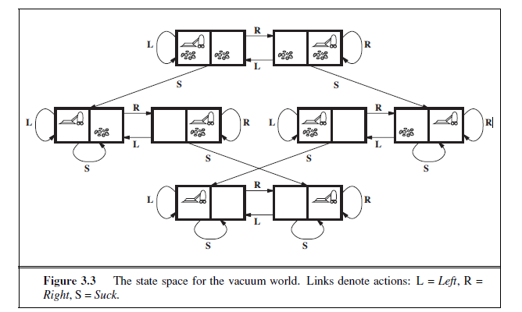
1.toy problem
States: Dirt and robot location
Actions: left ,right, suck
Goal test: no dirt at all locations
Path cost :1 per action

Slide 21
Toy problems
States: Dirt and robot location
Initial state: Any state can be designated as the initial state.
3.Actions: In this simple environment, each state has just three actions: Left, Right, and Suck. Larger environments might also include Up and Down.
4.Transition model: The actions have their expected effects, except that moving Left in the leftmost square, moving Right in the rightmost square, and Sucking in a clean square have no effect.
5.Goal test: This checks whether all the squares are clean
6.Path cost :Each step costs 1, so the path cost is the number of steps in the path.

Slide 22
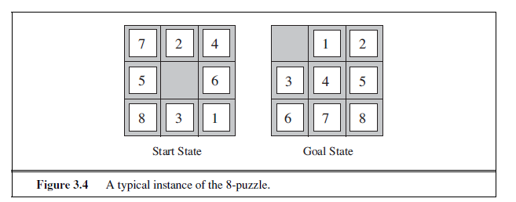
8-puzzle
States: A state description specifies the location of each of the eight tiles and the blank in one of the nine squares.
Initial state: Any state can be designated as the initial state.
Actions: Left, Right, Up, or Down.
Transition model: Given a state and action, this returns the resulting state; for example, if we apply Left to the start state in Figure 3.4, the resulting state has the 5 and the blank switched.
Goal test: This checks whether the state matches the goal configuration (Other goal configurations are possible.)
Path cost: Each step costs 1, so the path cost is the number of steps in the path

Slide 23
8-puzzle

Slide 24
8-queens problem
States: Any arrangement of 0 to 8 queens on the board is a state.
Initial state: No queens on the board.
Actions: Add a queen to any empty square.
Transition model: Returns the board with a queen added to the specified square.
Goal test: 8 queens are on the board, none attacked.

Slide 25
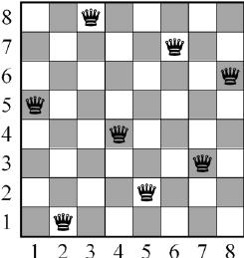
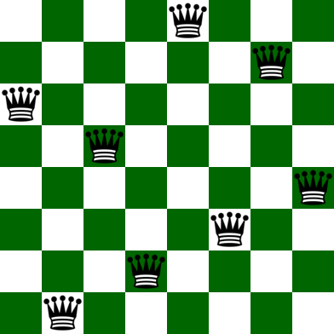

Slide 26
Real-world problems
Route finding problems
GPS based navigation systems GMAP
2. Touring Problems
TSP
3.VLSI Layout Problem: millions of components and connections on a chip to minimize area, minimize circuit delays, minimize stray capacitances. cell layout and channel routing
4. Robot Navigation Problem
5.Automatic assembly sequencing :
6.Internet Searching
7.Searching paths in metabolic networks in bioinformatics: protein design, in which the goal is to find a sequence of amino acids that will fold into a three-dimensional protein with the right properties to cure some disease.

Slide 27
SEARCHING FOR SOLUTIONS
A solution is an action sequence, so search algorithms work by considering various possible action sequences.
The possible action sequences starting at the initial state form a search tree with the initial state at the root .
a route from Arad to Bucharest.
The root node of the tree initial state, In(Arad).
The first step is to test whether this is a goal state.
Do this by expanding the current state; thereby generating a new set of states

Slide 28
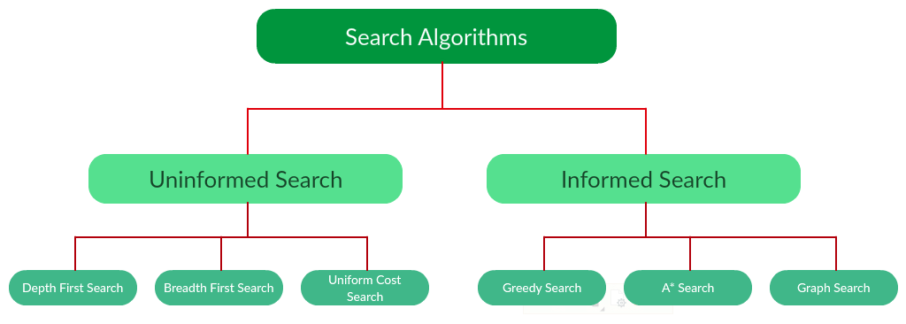
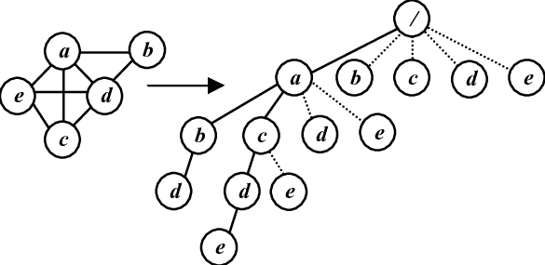

Slide 29
Add three branches from the parent node In(Arad) leading to three new child nodes: In(Sibiu), In(Timisoara), and In(Zerind).
Suppose we choose Sibiu first.
Whether it is a goal state (it is not) and then expand it to get In(Arad), In(Fagaras), In(Oradea), and In(RimnicuVilcea).
Choose any of these four or go back and choose Timisoara or Zerind.
Each of these six nodes is a leaf node, that is, a node with no children in the tree.
The set of all leaf nodes available for expansion at any given point is called the frontier.

Slide 30
it includes the path from Arad to Sibiu and back to Arad again!
In(Arad) is a repeated state in the search tree, generated in this case by a loopy path.
Considering such loopy paths means that the complete search tree for Romania is infinite because there is no limit to how often one can traverse a loop.

Slide 31
Loopy paths are a special case redundant paths whenever there is more than one way to get from one state to another.
Consider the paths Arad–Sibiu (140 km long) and Arad–Zerind–Oradea–Sibiu (297 km long).
second path is redundant

Slide 33
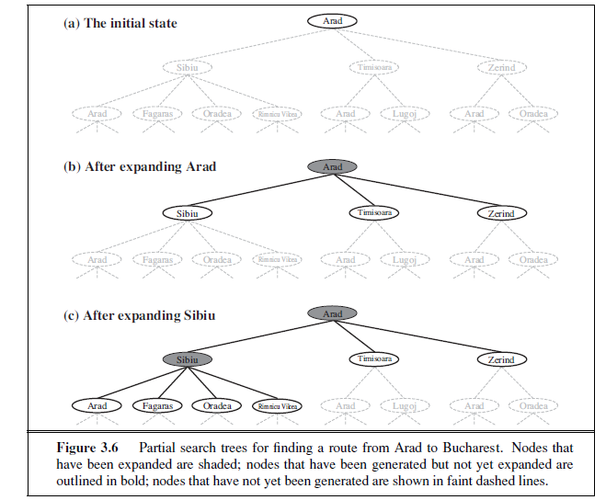

Slide 34
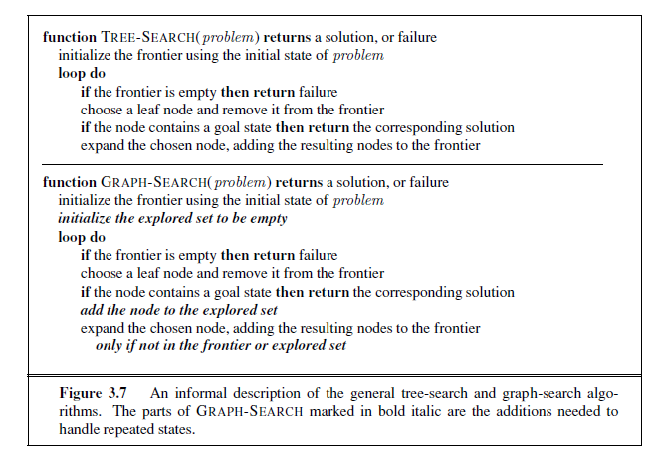

Slide 35
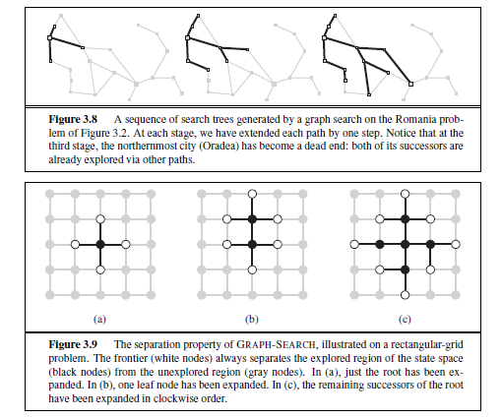

Slide 36
the search tree constructed by the GRAPH-SEARCH algorithm contains at most one copy of each state, so we can think of it as growing a tree directly on the state-space graph, as shown in Figure 3.8.
the frontier separates the state-space graph into the explored region and the unexplored region, so that every path from the initial state to an unexplored state has to pass through a state in the frontier

Slide 37
Infrastructure for search algorithms
Search algorithms require a data structure for the search tree. Each node n of the tree, a structure has four components
n.STATE: the state in the state space to which the node corresponds;
n.PARENT: the node in the search tree that generated this node;
n.ACTION: the action that was applied to the parent to generate the node;
n.PATH-COST: the cost by g(n), of the path from the initial state to the node, as indicated by the parent pointers.

Slide 38
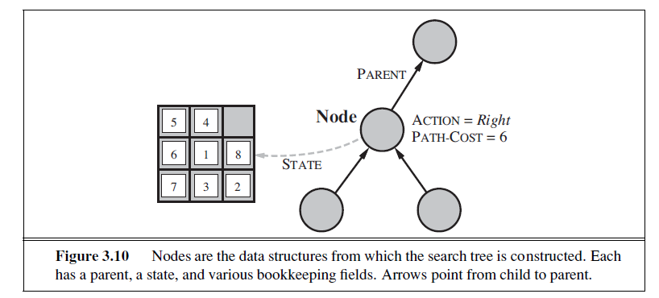
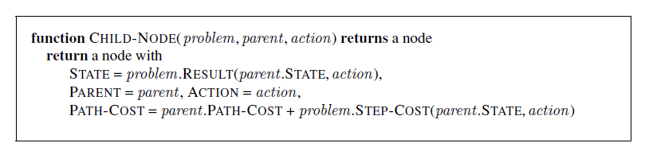

Slide 39
The appropriate data structure for this is a queue.
The operations on a queue are as follows:
EMPTY?(queue) returns true only if there are no more elements in the queue.
POP(queue) removes the first element of the queue and returns it.
INSERT(element, queue) inserts an element and returns the resulting queue.

Slide 40
Queues are characterized by the order in which they store the inserted nodes.
first-in, first-out or FIFO queue, pops the oldest element of the queue;
last-in, first-out or LIFO queue (also known as a stack),pops the newest element of the queue;
priority queue, pops the element of the queue with the highest priority according to some ordering function.

Slide 41
Measuring problem-solving performance
design of specific search algorithms
Completeness: Is the algorithm guaranteed to find a solution when there is one?
Optimality: Does the strategy find the optimal solution
Time complexity: How long does it take to find a solution?
Space complexity: How much memory is needed to perform the search?

Slide 42
size of the state space graph, |V | + |E|, where V is the set of vertices (nodes) of the graph and E is the set of edges (links).
complexity is expressed in three quantities:
b:Maximum branch factor of the search tree
d:depth of the least cost solution to reach the goal
m:maximum depth of the state space

Slide 43
search cost—
can use the total cost, which combines the search cost and the path cost of the solution found.
Ex:For the problem of finding a route from Arad to Bucharest, the search cost is the amount of time taken by the search and the solution cost is the total length of the path in kilometers.
to compute the total cost, to add milliseconds and kilometers

Slide 44
UNINFORMED SEARCH STRATEGIES
Blind search.
No additional information about states except the one provided in the problem definition.
All they can do is generate successors and distinguish a goal state from a non-goal state.
search strategies -by the order in which nodes are expanded.
Strategies that know -goal state informed search or heuristic search strategies;
BFS
DFS

Slide 45
BREADTH-FIRST
Root node is expanded first then all the successors of the root node are expanded next, then their successors, and so on.
All the nodes are expanded at a given depth in the search tree before any nodes at the next level are expanded.
Based on general graph-search algorithm ,shallowest unexpanded node is chosen for expansion.
This is achieved very simply by using a FIFO queue for the frontier.
new nodes (which are always deeper than their parents) go to the back of the queue, and old nodes, which are shallower than the new nodes, get expanded first.

Slide 46
Breadth First Search(BFS)
The root node is expanded first
Then all the successors of the root node are expanded.
Then all their successors and so on.
All the of a given depth are expanded before any node of the next depth is expanded.
Uses a standard queue FIFO as a data structure .

Slide 47
BFS
BFS is complete(always finds goal if one exists)
BFS finds the shallowest path to any goal node,if multiple goal nodes exist ,BFS finds the shortest path
If the shallowest solution is at depth ‘d’ and the goal test is done when each node is generated then BFS generates b+b²+b³ ….+b^{d} =O(b^{d}) nodes that has time complexity of O(b^{d})
If the goal test is done when each node is expanded the time complexity of BFS is O(b^{d+1})
The space complexity (frontier size)is also O(b^{d}) .This is the biggest drawback of BFS

Slide 48
Imagine searching a uniform tree where every state has b successors.
The root of the search tree generates b nodes at the first level, each of which generates b more nodes, for a total of b² at the second level. Each of these generates b more nodes, yielding b³ nodes at the third level, and so on. Now suppose that the solution is at depth d. In the worst case, it is the last node generated at that level.
b+b²+b³ ….+b^{d}
(If the algorithm were to apply the goal test to nodes when selected for expansion, rather than when generated, the whole layer of nodes at depth d would be expanded before the goal was detected and the time complexity would be O(b^{d+1})

Slide 49
As for space complexity: for any kind of graph search, which stores every expanded node in the explored set, the space complexity is always within a factor of b of the time complexity. For breadth-first graph search in particular, every node generated remains in memory. There will be O(b^{d−1}) nodes in the explored set and O(b^{d}) nodes in the frontier, so the space complexity is O(b^{d}),

Slide 50
Limitations of BFS
memory requirements are a bigger problem for breadth-first search than is the execution time.
Time is still a major factor.

Slide 51
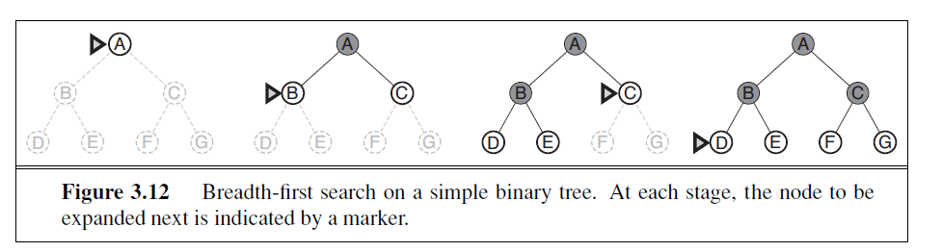

Slide 52
Breadth-First Strategy
New nodes are inserted at the end of FRINGE
1
2
3
FRINGE = (1)
4
5
6
7

Slide 53
Breadth-First Strategy
New nodes are inserted at the end of FRINGE
1
2
3
FRINGE = (2, 3)
4
5
6
7

Slide 54
Breadth-First Strategy
New nodes are inserted at the end of FRINGE
1
2
3
FRINGE = (3, 4, 5)
4
5
6
7

Slide 55
Breadth-First Strategy
New nodes are inserted at the end of FRINGE
1
2
3
FRINGE = (4, 5, 6, 7)
4
5
6
7

Slide 56
import collections
def bfs(graph, root):
visited, queue = set(), collections.deque([root])
visited.add(root)
while queue:
# Dequeue a vertex from queue
vertex = queue.popleft()
print(str(vertex) + " ", end="")
# If not visited, mark it as visited, and enqueue it
for neighbour in graph[vertex]:
if neighbour not in visited:
visited.add(neighbour)
queue.append(neighbour)
if __name__ == '__main__':
graph = {0: [1, 2], 1: [2], 2: [3], 3: [1, 2]}
print("Following is Breadth First Traversal: ")
bfs(graph, 0)

Slide 57
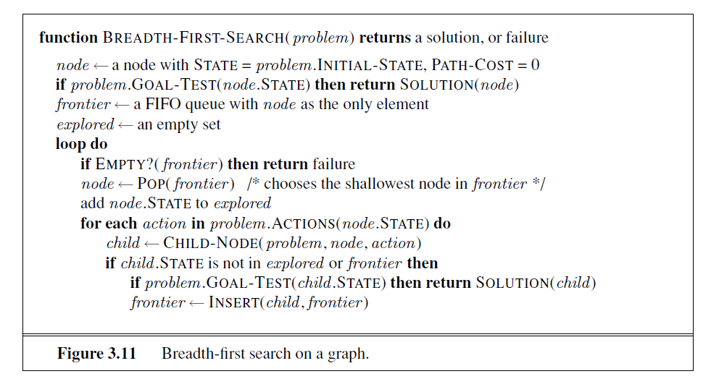

Slide 58
Depth-first search
Expands the deepest node in the current frontier of the search tree.
It uses Stack (LIFO queue),means that the most recently generated node is chosen for expansion
DFS is frequently programmed recursively.

Slide 59
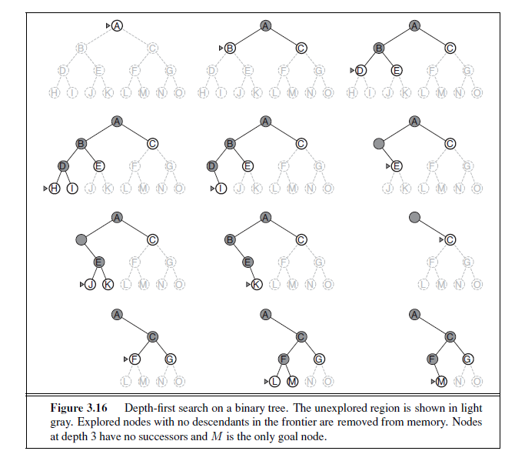

Slide 60
DFS
The properties of DFS based on graph-search or tree-search used.
The graph-search version, avoids repeated states and redundant paths, is complete in finite state spaces because it will eventually expand every node.
Can be modified at no extra memory cost so that it checks new states against those on the path from the root to the current node; this avoids infinite loops in finite state spaces but does not avoid the proliferation of redundant paths.
In infinite state spaces, both versions fail if an infinite non-goal path is encountered.

Slide 62
DFS
Generate all of the O(b^{m}) nodes in the search tree, where m is the maximum depth of any node; this
‘m’ itself can be much larger than ‘d’ the depth of the shallowest solution and is infinite if the tree is unbounded.
For a state space with branching factor b and maximum depth m, depth-first search requires storage of only O(bm) nodes.
variant of depth-first search called backtracking search uses still less memory

Slide 63
The reason is the space complexity. For a graph search, there is no advantage, but a depth-first tree search needs to store only a single path from the root to a leaf node, along with the remaining unexpanded sibling nodes for each node on the path. Once a node has been expanded, it can be removed from memory as soon as all its descendants have been fully explored.
For a state space with branching factor b and maximum depth m, depth-first search requires storage of only O(bm) nodes.
Using the same assumptions as for Figure 3.13 and assuming that nodes at the same depth as the goal node have no successors, we find that depth-first search would require 156 kilobytes instead of 10 exabytes at depth d = 16, a factor of 7 trillion times less space

Slide 64
BACKTRACKING SEARCH
A variant of depth-first search called backtracking search uses still less memory.
In backtracking, only one successor is generated at a time rather than all successors; each partially expanded node remembers which successor to generate next.
In this way, only O(m) memory is needed rather than O(bm).
Backtracking search facilitates yet another memory-saving (and time-saving) trick: the idea of generating a successor by modifying the current state description directly rather than copying it first.
This reduces the memory requirements to just one state description and O(m) actions.

Slide 65
graph = {
'0':['1', '2'], '1':['2'],'2':['3'],'3':['1', '2']
}
visited =set()
def dfs(visited,graph,root):
if root not in visited:
print(root)
visited.add(root)
for neighbour in graph[root]:
dfs(visited,graph,neighbour)
dfs(visited,graph,'0')

Slide 66
INFORMED (HEURISTIC) SEARCH STRATEGIES
uses problem-specific knowledge -can find solutions more efficiently than can an uninformed strategy.
General approach is best-first search.
Best-first search is an instance of TREE-SEARCH or GRAPH-SEARCH algorithm in which a node is selected for expansion based on an evaluation function, f(n).

Slide 67
INFORMED (HEURISTIC) SEARCH STRATEGIES
The evaluation function is construed as a cost estimate, so the node with the lowest evaluation is expanded first
Informed search algorithms include a heuristic function h(n) as a part of f(n)
f(n)=g(n)+h(n) g(n)→ the cost to reach the node
h(n)=estimate of the cheapest cost form the state at node n to a goal state;
h(goal)=0

Slide 68
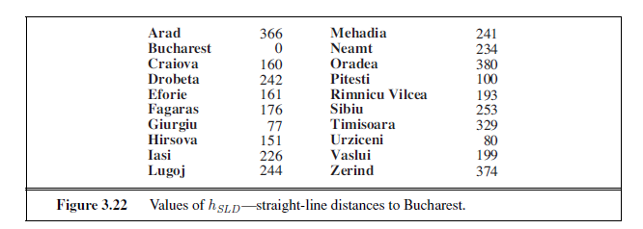
Greedy best-first search
GFS tries to expand the node that it estimates as being closest to the goal.
likely to lead to a solution quickly
It uses only the heuristic function h(n).
f(n)=h(n).
Use a straight line distance(SLD) heuristic h_{SLD} for the route finding in Romania to the goal Bucharest.
h_{SLD}(In(Arad))=366. values of h_{SLD} cannot be computed from the problem description itself.
It takes a certain amount of experience to know that h_{SLD} is correlated with actual road distances and is, therefore, a useful heuristic.

Slide 69
greedy best-first search using h_{SLD} to find a path from Arad to Bucharest.
The first node to be expanded from Arad will be Sibiu because it is closer to Bucharest than either Zerind or Timisoara.
The next node to be expanded will be Fagaras because it is closest. Fagaras in turn generates Bucharest, which is the goal.
For this particular problem, greedy best-first search using hSLD finds a solution without ever expanding a node that is not on the solution path; hence, its search cost is minimal.

Slide 70
It is not optimal, however: the path via Sibiu and Fagaras to Bucharest is 32 kilometers longer than the path through Rimnicu Vilcea and Pitesti. “greedy”—at each step it tries to get as close to the goal as it can.

Slide 71
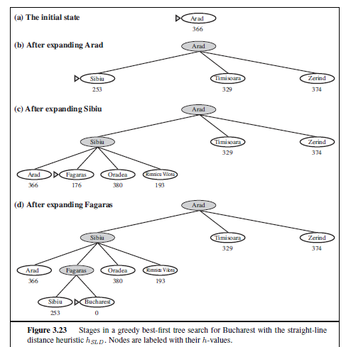

Slide 72
The algorithm is called greedy because in each step the algorithm greedily tries to get as close to the goal as possible.
time and space complexity for the tree version is O(b^{m}),
Suggestion for improvement :use the accumulated path distance g(n) plus a heuristic h(n) as cost function f(n).This leads to A*

Slide 73
Consider the problem of getting from Iasi to Fagaras.
The heuristic suggests that Neamt be expanded first because it is closest to Fagaras, but it is a dead end.
The solution is to go first to Vaslui—a step that is actually farther from the goal according to the heuristic—and then to continue to Urziceni, Bucharest, and Fagaras.
The algorithm will never find this solution, however, because expanding Neamt puts Iasi back into the frontier, Iasi is closer to Fagaras than Vaslui is, and so Iasi will be expanded again, leading to an infinite loop.

Slide 74
The worst-case time and space complexity for the tree version is O(b^{m}), where m is the maximum depth of the search space.

Slide 75
A* search: Minimizing the total estimated solution cost
It evaluates nodes by combining g(n), the cost to reach the node, and h(n), the cost to get from the node to the goal:
f(n) = g(n) + h(n) .
g(n) gives the path cost from the start node to node n,
h(n) is the estimated cost to reach the goal.
f(n) = estimated cost of the cheapest solution through n .
Under certain conditions A∗ search is both complete and optimal.

Slide 77
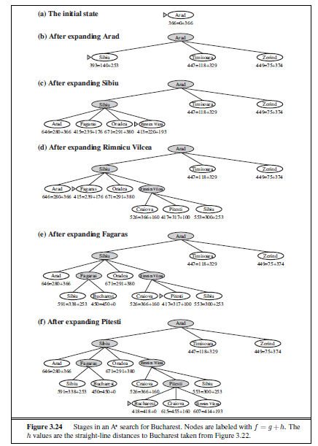

Slide 79
Conditions for optimality: Admissibility and consistency
The first condition for optimality is h(n) be an admissible heuristic.
An admissible heuristic is one that never overestimates the cost to reach the goal.
f(n)=g(n) + h(n), f(n) never overestimates the true cost of a solution along the current path through n.
Admissible heuristics are by nature optimistic because they think the cost of solving the problem is less than it actually is. Straight-line distance h_{SLD} getting to Bucharest.

Slide 80
Graph_nodes = {
'A': [('B', 6), ('F', 3)],
'B': [('C', 3), ('D', 2)],
'C': [('D', 1), ('E', 5)],
'D': [('C', 1), ('E', 8)],
'E': [('I', 5), ('J', 5)],
'F': [('G', 1),('H', 7)] ,
'G': [('I', 3)],
'H': [('I', 2)],
'I': [('E', 5), ('J', 3)],
}
def get_neighbors(v):
if v in Graph_nodes:
return Graph_nodes[v]
else:
return None

Slide 81
def h(n):
H_dist = {
'A': 10,
'B': 8,
'C': 5,
'D': 7,
'E': 3,
'F': 6,
'G': 5,
'H': 3,
'I': 1,
'J': 0
}
return H_dist[n]

Slide 82
def aStarAlgo(start_node, stop_node):
open_set = set(start_node)
closed_set = set()
g = {}
parents = {}
g[start_node] = 0
parents[start_node] = start_node
while len(open_set) > 0:
n = None
for v in open_set:
if n == None or g[v] + h(v) < g[n] + h(n):
n = v
if n == stop_node or Graph_nodes[n] == None:
pass
else:
for (m, weight) in get_neighbors(n):
if m not in open_set and m not in closed_set:
open_set.add(m)
parents[m] = n
g[m] = g[n] + weight
else:
if g[m] > g[n] + weight:
g[m] = g[n] + weight
parents[m] = n
if m in closed_set:
closed_set.remove(m)
open_set.add(m)

Slide 83
if n == None:
print('Path does not exist!')
return None
if n == stop_node:
path = []
while parents[n] != n:
path.append(n)
n = parents[n]
path.append(start_node)
path.reverse()
print('Path found: {}'.format(path))
return path
open_set.remove(n)
closed_set.add(n)
print('Path does not exist!')
return None
aStarAlgo('A', 'J')

Slide 84
Conditions for optimality: Admissibility and consistency
A second, stronger condition consistency or monotonicity is required only for applications of A∗ to graph search.
A heuristic h(n) is consistent if, for every node n and every successor n| of n generated by any action a, the estimated cost of reaching the goal from n is no greater than the step cost of getting to n plus the estimated cost of reaching the goal from n is no greater than the step cost of getting to n plus the estimated cost of reaching the goal from n|
h(n) ≤ c(n, a, n| ) ) + h(n| )
This is a form of the general triangle inequality which stipulates that each side of a triangle cannot be longer than the sum of the other two sides. Here, the triangle is formed by n, n|,and the goal G_{n} closest to n.

Slide 85
Conditions for optimality of A*
tree-search version of A* is optimal
h(n) must be admissible, i.e it never overestimates the cost to reach the goal.
Then, as a consequence ,f(n)=g(n)+h(n) never overestimates the true cost of a solution along the current path through n.
h(n) must be consistent (monotonic)in a graph search, i.e for every node n and every successor n| of n generated by action a ,
h(n) ≤ c(n, a, n| ) + h(n| )
This is a form of the triangular inequality.
Every consistent heuristic is also admissible.
hello

Slide 86

Optimality in A*
tree-search version of A* is optimal if h(n) is admissible , graph search version of A* is optimal if h(n) is consistent . We show this in 2 steps.
1.if h(n) is consistent then the values of f(n) along any path are non-decreasing.
Suppose n| is a successor of n then for some action a we have
Whenever A* selects a node n for expansion ,the optimal path to that node has been found.
Otherwise there must be another frontier node n| on the optimal path from start node to n; as f is nondecreasing along any path , n| would have lower f cost than n and would have been selected first.

Slide 87
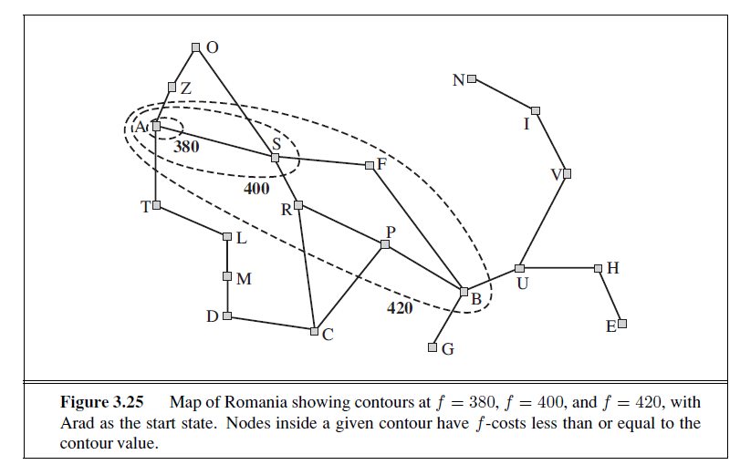

Slide 88
Heuristic functions
A typical instance of the 8-puzzle. The solution is 5 steps long
The 8-puzzle was one of the earliest heuristic search problems.
1 | 2 | 3
4 | 8 | -
7 | 6 | 5
1 | 2 | 3
4 | 5 | 6
7 | 8 | -

Slide 89
Heuristic functions
8-puzzle was one of the earliest heuristic search problems.
The object of the puzzle is to slide the tiles horizontally or vertically into the empty space until the configuration matches the goal configuration.
The average solution cost for a randomly generated 8-puzzle instance is about 22 steps.
The branching factor is about 3. (When the empty tile is in the middle, four moves are possible; when it is in a corner, two; and when it is along an edge, three.

Slide 90
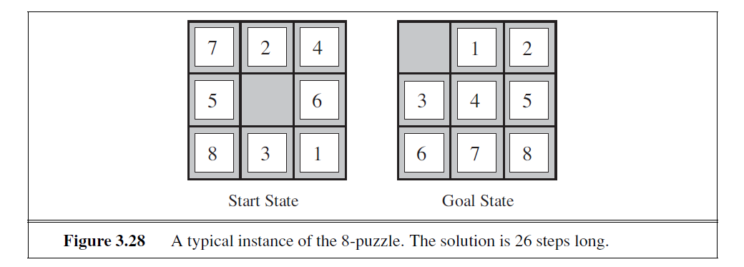
an exhaustive tree search to depth 22 would look at about 3²² ≈ 3.1×10¹⁰ states.
h1 = the number of misplaced tiles.
Figure 3.28, all of the eight tiles are out of position, so the start state would have h1 = 8.
h1 is an admissible heuristic because it is clear that any tile that is out of place must be moved at least once.

Slide 91
h2 = the sum of the distances of the tiles from their goal positions.
Because tiles cannot move along diagonals, the distance we will count is the sum of the horizontal and vertical distances. This is sometimes called the city block distance or Manhattan distance.
city block distance or Manhattan distance.
h2 = 3+1 + 2 + 2+ 2 + 3+ 3 + 2 = 18 .

Slide 92

The effect of heuristic accuracy on performance
One way to characterize the quality of a heuristic is the effective branching factor b*.
If the total number of nodes generated by A∗ for a particular problem is N and the solution depth is d, then b∗ is the branching factor that a uniform tree of depth d would have to have in order to contain N + 1 nodes. Thus,
For example, if A∗ finds a solution at depth 5 using 52 nodes, then the effective branching factor is 1.92

